Slide 1


PYTHON
Lecture 44

Slide 2

Today’s Agenda
Advance Concepts Of Object Oriented Programming-II
Inheritance
Types Of Inheritance
Single Inheritance
Using super( )
Method Overriding

Slide 3
Inheritance
Inheritance is a powerful feature in object oriented programming.
It refers to defining a new class with little or no modification to an existing class.
The new class is called derived (or child) class and the one from which it inherits is called the base (or parent) class.

Slide 4
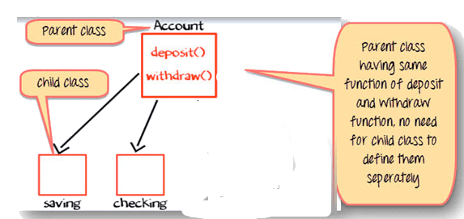
Real Life Examples

Slide 5
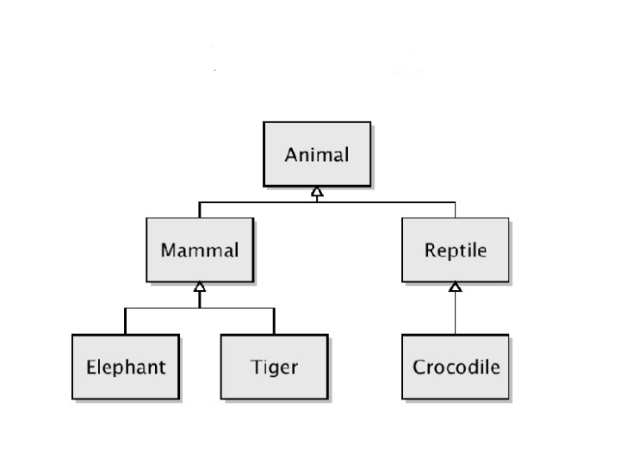
Real Life Examples

Slide 6
Benefits
It represents real-world relationships well.
It provides reusability of a code. We don’t have to write the same code again and again.
It also allows us to add more features to a class without modifying it.

Slide 7
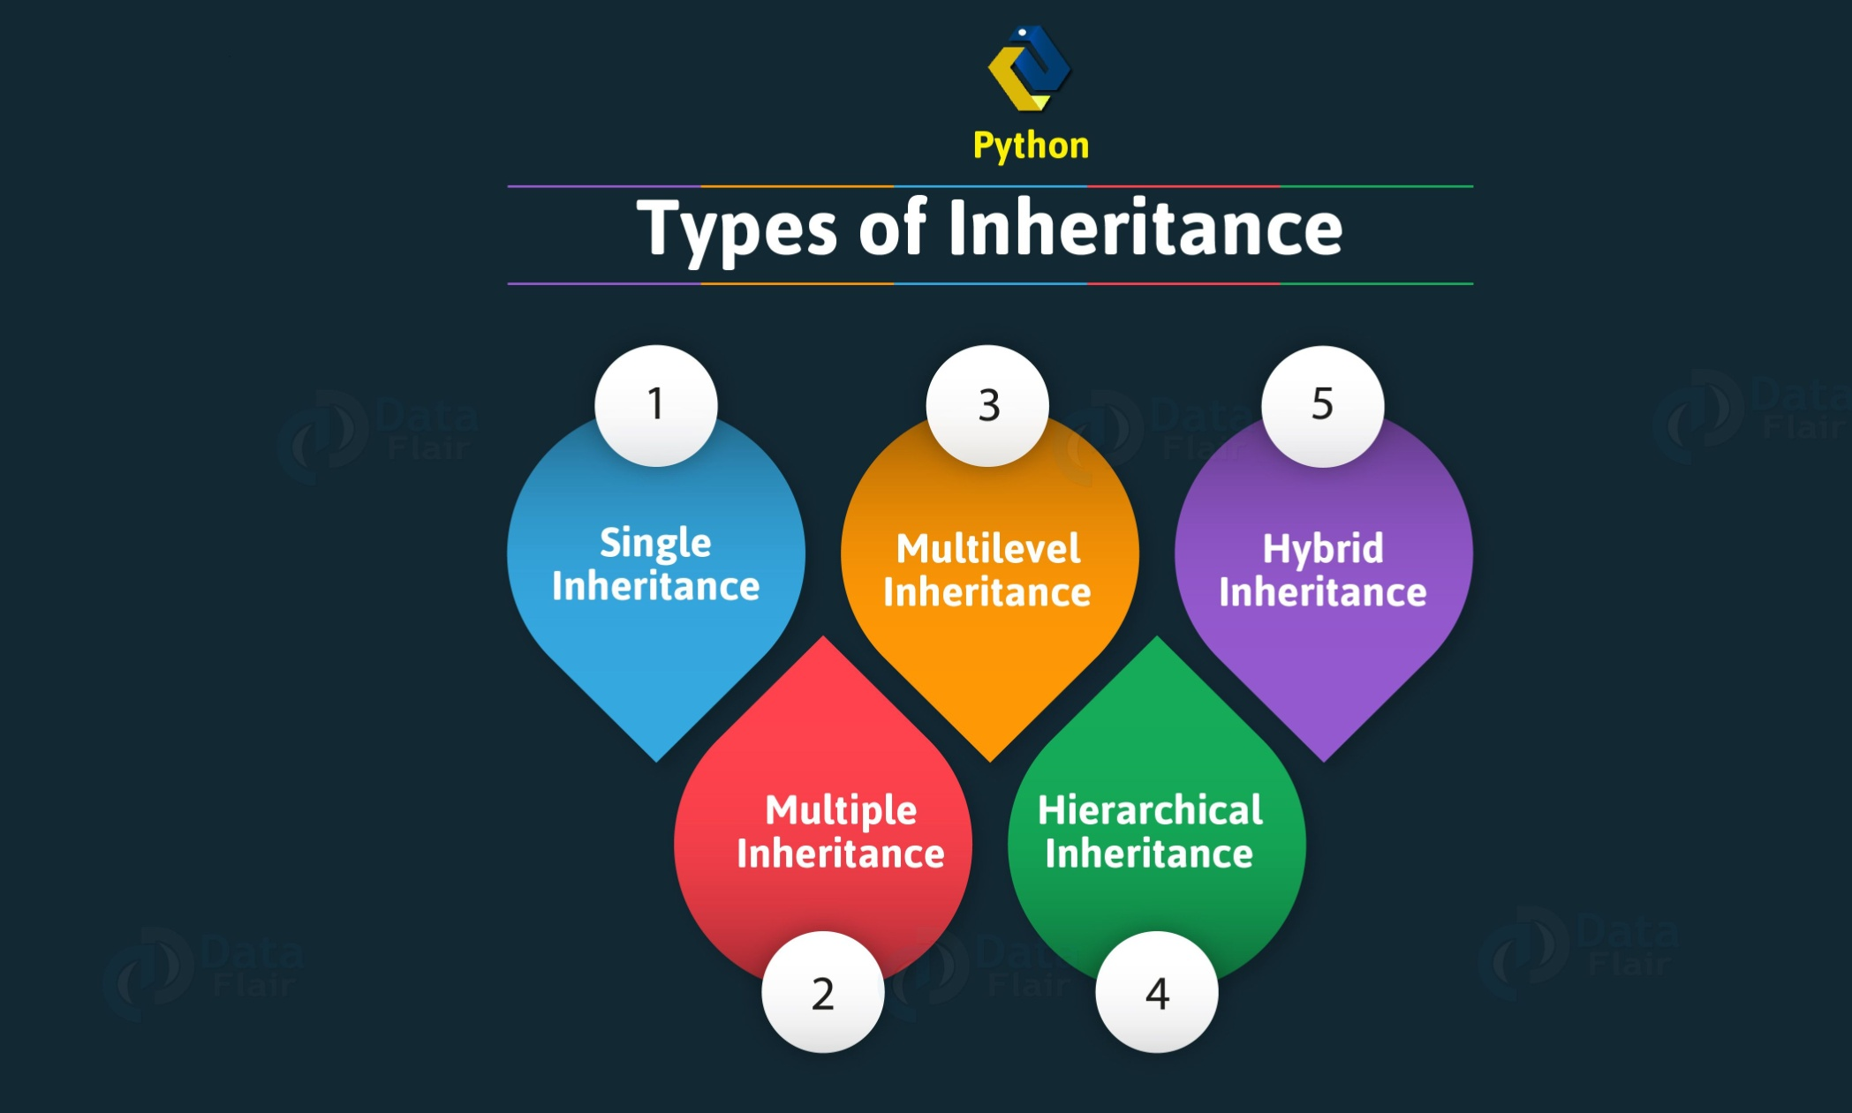
Types Of Inheritance Supported By Python

Slide 8
Syntax Of Single Inheritance In Python
class BaseClass:
Body of base class
class DerivedClass(BaseClass):
Body of derived class
For Ex:
class Account:
pass
class SavingAccount(Account):
pass

Slide 9
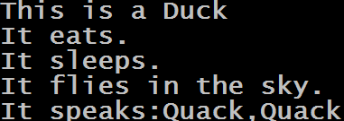
Example
duck=Bird()
duck.set_type("Duck")
print(duck)
duck.eat()
duck.sleep()
duck.fly()
duck.speak("Quack")
Output:
class Animal:
def eat(self):
print("It eats.")
def sleep(self):
print("It sleeps.")
class Bird(Animal):
def set_type(self,type):
self.type=type
def fly(self):
print("It flies in the sky.")
def speak(self,sound):
print(f"It speaks:{sound},{sound}")
def __repr__(self):
return "This is a "+self.type;

Slide 10
Using super()
In Python , to call parent class members from the child class we can use the method super( ).
Using super() is required in 2 situations:
For calling parent class constructor
For calling overridden methods

Slide 11
How Constructors Behave In Inheritance ?
Whenever we create a child class object , Python looks for __init__() method in child class.
If the child class doesn’t contain an __init__() method then Python goes up in the inheritance chain and looks for the __init__() method of parent class

Slide 12
How Constructors Behave In Inheritance ?
If the parent class contains __init__() , then it execute it .
Now an important point to notice is that if child class also has __init__() , then Python will not call parent’s __init__() method.
That is , unlike Java or C++ , Python does not automatically call the parent class __init__() if it finds an __init__() method in child class

Slide 13

How Constructors Behave In Inheritance ?
class A:
def __init__(self):
print("Instantiating A...")
class B(A):
pass
b=B()
Output:
As you can see, Python called the constructor of class A , since B class doesn’t has any constructor defined

Slide 14
How Constructors Behave In Inheritance ?
class A:
def __init__(self):
print("Instantiating A...")
class B(A):
def __init__(self):
print("Instantiating B...")
b=B()
Output:
This time , Python did not call the constructor of class A as it found a constructor in B itself

Slide 15
How Constructors Behave In Inheritance ?
So , what is the problem if parent constructor doesn’t get called ?
The problem is that , if parent class constructor doesn’t get called then all the instance members it creates will not be made available to child class

Slide 16
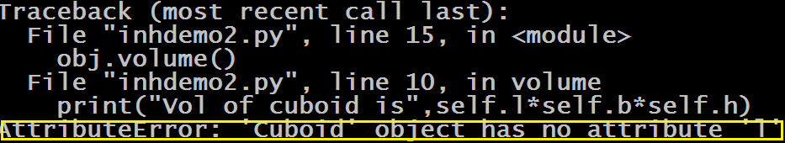
How Constructors Behave In Inheritance ?
Since , constructor of Rectangle was not called , so the expression self.l produced exception because there is no attribute created by the name of l
class Rectangle:
def __init__(self):
self.l=10
self.b=20
class Cuboid(Rectangle):
def __init__(self):
self.h=30
def volume(self):
print("Vol of cuboid is",self.l*self.b*self.h)
obj=Cuboid()
obj.volume()
Output:

Slide 17
How Can We Explicitly Call __init__() Of Parent Class ?
If we want to call the parent class __init__() , then we will have 2 options:
Call it using the name of parent class explicitly
Call it using the method super()

Slide 18
Calling Parent Constructor Using Name
Notice that we have to explicitly pass the argument self while calling __init__() method of parent class
class Rectangle:
def __init__(self):
self.l=10
self.b=20
class Cuboid(Rectangle):
def __init__(self):
Rectangle.__init__(self)
self.h=30
def volume(self):
print("Vol of cuboid is",self.l*self.b*self.h)
obj=Cuboid()
obj.volume()
Output:

Slide 19
Calling Parent Constructor Using super( )
Again notice that this time we don’t have to pass the argument self when we are using super( ) as Python will automatically pass it
class Rectangle:
def __init__(self):
self.l=10
self.b=20
class Cuboid(Rectangle):
def __init__(self):
super().__init__();
self.h=30
def volume(self):
print("Vol of cuboid is",self.l*self.b*self.h)
obj=Cuboid()
obj.volume()
Output:

Slide 20
What Really Is super( ) ?
The method super() is a special method made available by Python which returns a proxy object that delegates method calls to a parent class
In simple words the method super( ) provides us a special object that can be used to transfer call to parent class methods

Slide 21
Benefits Of super( )
A common question that arises in our mind is that why to use super( ) , if we can call the parent class methods using parent class name.
The answer is that super( ) gives 4 benefits:
We don’t have to pass self while calling any method using super( ).
If the name of parent class changes after inheritance then we will not have to rewrite the code in child as super( ) will automatically connect itself to current parent
It can be used to resolve method overriding
It is very helpful in multiple inheritance

Slide 22
Method Overriding
To understand Method Overriding , try to figure out the output of the code given in the next slide

Slide 23
Guess The Output ?
class Person:
def __init__(self,age,name):
self.age=age
self.name=name
def __repr__(self):
return f"Age:{self.age},Name:{self.name}"
class Emp(Person):
def __init__(self,age,name,id,sal):
super().__init__(age,name)
self.id=id
self.sal=sal
e=Emp(24,"Nitin",101,45000)
print(e)
Output:

Slide 24
Explanation
As we know , whenever we pass the name of an object reference as argument to the function print( ) , Python calls the method __repr__().
But since the class Emp doesn’t has this method , so Python moves up in the inheritance chain to find this method in the base class Person
Now since the class Person has this method , Python calls the __repr__() method of Person which returns only the name and age

Slide 25
Method Overriding
Now if we want to change this behavior and show all 4 attributes of the Employee i.e. his name , age ,id and salary, then we will have to redefine the method __repr__() in our Emp class.
This is called Method Overriding
Thus , Method Overriding is a concept in OOP which occurs whenever a derived class redefines the same method as inherited from the base class

Slide 26
Modified Example
class Person:
def __init__(self,age,name):
self.age=age
self.name=name
def __repr__(self):
return f"Age:{self.age},Name:{self.name}"
class Emp(Person):
def __init__(self,age,name,id,sal):
super().__init__(age,name)
self.id=id
self.sal=sal
def __repr__(self):
return f"Age:{self.age},Name:{self.name},Id:{self.id},Salary:{self.sal}"
e=Emp(24,"Nitin",101,45000)
print(e)
Output:

Slide 27
Role Of super( ) In Method Overriding
When we override a method of base class in the derived class then Python will always call the derive’s version of the method.
But in some cases we also want to call the base class version of the overridden method.
In this case we can call the base class version of the method from the derive class using the function super( )
Syntax:
super( ). <method_name>(<arg>)

Slide 28
Modified Example
class Person:
def __init__(self,age,name):
self.age=age
self.name=name
def __repr__(self):
return f"Age:{self.age},Name:{self.name}"
class Emp(Person):
def __init__(self,age,name,id,sal):
super().__init__(age,name)
self.id=id
self.sal=sal
def __repr__(self):
str=super().__repr__()
return f"{str},Id:{self.id},Salary:{self.sal}"
e=Emp(24,"Nitin",101,45000)
print(e)
Output:

Slide 29
Exercise
Write a program to create a class called Circle having an instance member called radius. Provide following methods in Circle class
__init___() : This method should accept an argument and initialize radius with it
area(): This method should calculate and return Circle’s area
Now create a derived class of Circle called Cylinder having an instance member called height. Provide following methods in Cylinder class
__init___() : This method should initialize instance members radius and height with the parameter passed.
area( ): This method should override Circle’s area( ) to calculate and return area of Cylinder . ( formula: 2πr²+2πrh)
volume(): This method should calculate and return Cylinder’s volume(formula: πr²h)

Slide 30
Solution
obj=Cylinder(10,20)
print("Area of cylinder is",obj.area())
print("Volume of cylinder is",obj.volume())
import math
class Circle:
def __init__(self,radius):
self.radius=radius
def area(self):
return math.pi*math.pow(self.radius,2)
class Cylinder(Circle):
def __init__(self,radius,height):
super().__init__(radius)
self.height=height
def area(self):
return 2*super().area()+2*math.pi*self.radius*self.height
def volume(self):
return super().area()*self.height
Output:

Slide 31
A Very Important Point!
Can we call the base class version of an overridden method from outside the derived class ?
For example , in the previous code we want to call the method area( ) of Circle class from our main script . How can we do this ?
Yes this is possible and for this Python provides us a special syntax:
Syntax:
<base_class_name>.<method_name>(<der_obj>)

Slide 32

Example
obj=Cylinder(10,20)
print("Area of cylinder is",obj.area())
print("Volume of cylinder is",obj.volume())
print("Area of Circle:",Circle.area(obj))
import math
class Circle:
def __init__(self,radius):
self.radius=radius
def area(self):
return math.pi*math.pow(self.radius,2)
class Cylinder(Circle):
def __init__(self,radius,height):
super().__init__(radius)
self.height=height
def area(self):
return 2*super().area()+2*math.pi*self.radius*self.height
def volume(self):
return super().area()*self.height
Output:
By calling in this way we can bypass the area( ) method of Cylinder and directly call area( ) method of Circle

